Slide 1
Research Report
Vo Khoi Thanh Son
16-7-2024

Slide 2
Project Goal
- Implement RL algorithm to train soft grippers to grasp different objects and transfer to the real world environment.
- Train a single policy that can generalize to
different types of grippers
different object shapes
- 2-stage teacher-student paradigm
Teacher policy: privileged state information (gripper’s pose, gripper joints (dofs), object pose, object id
Student policy: imitate the teacher using visual inputs from the camera
Position control (DOF_MODE_POS)
Control gripper’s base
Effort control (DOF_MODE_EFFORT)
Control the action of opening and closing the fingers

Slide 3
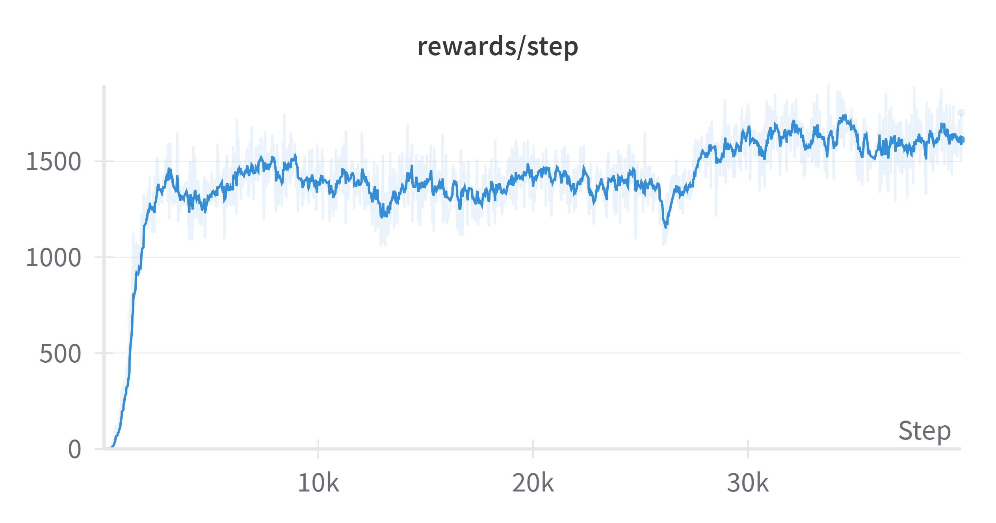
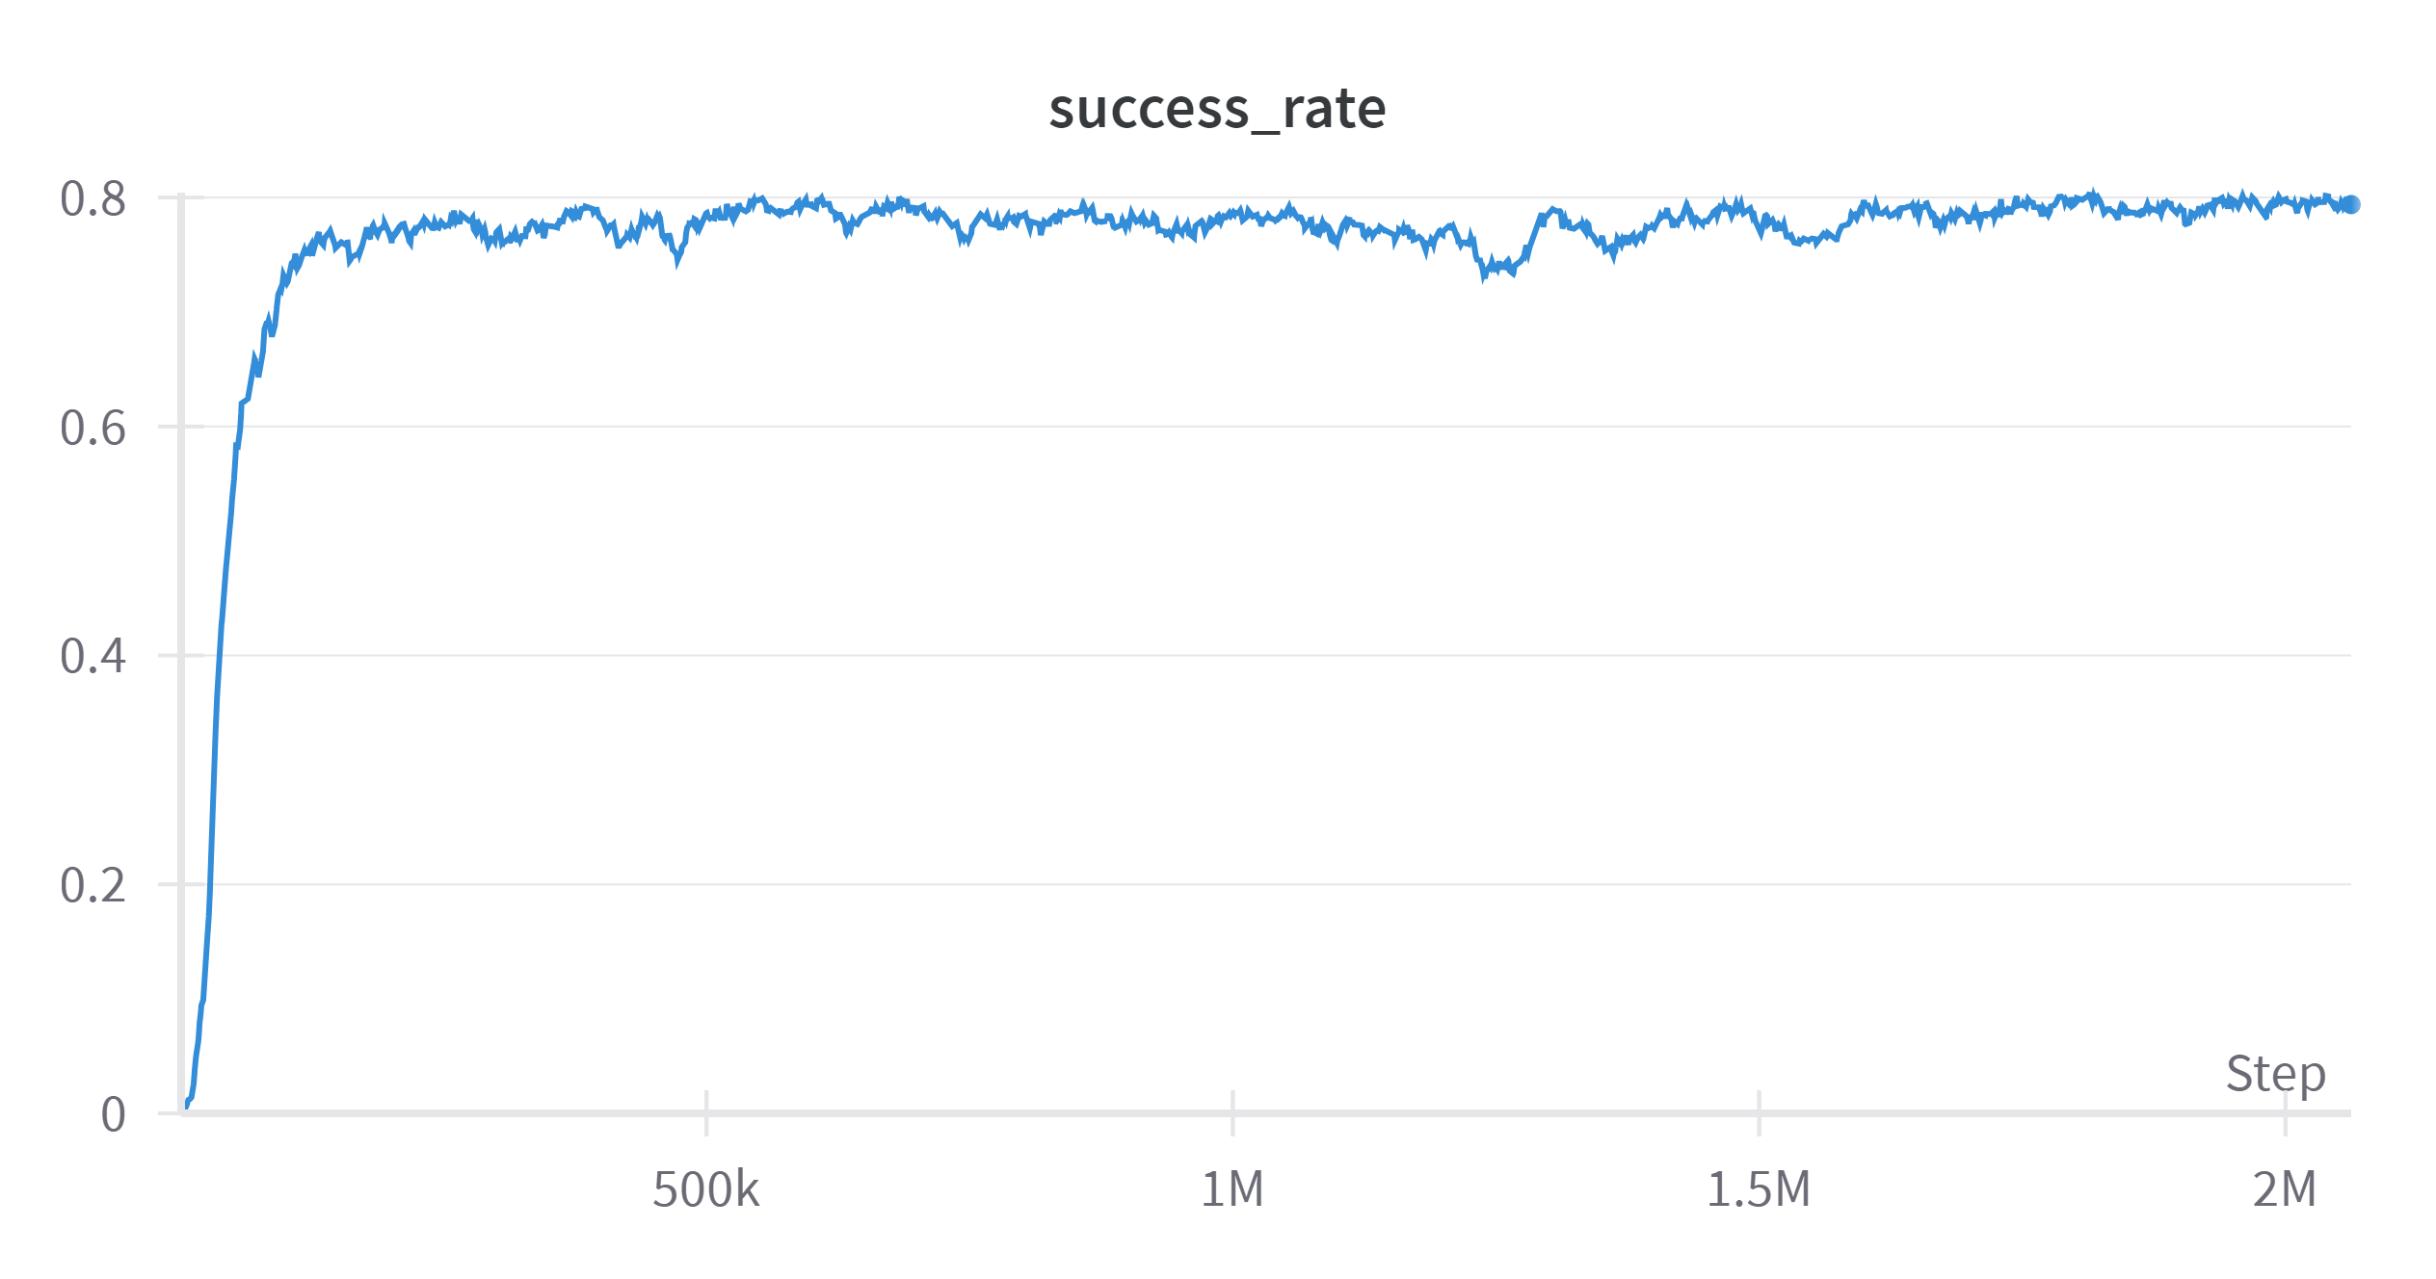
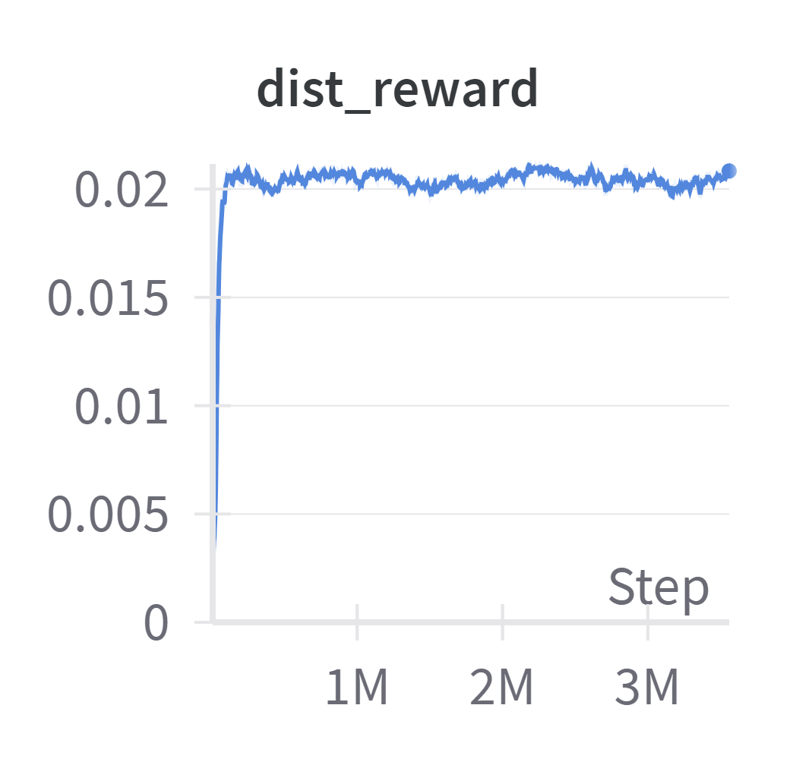
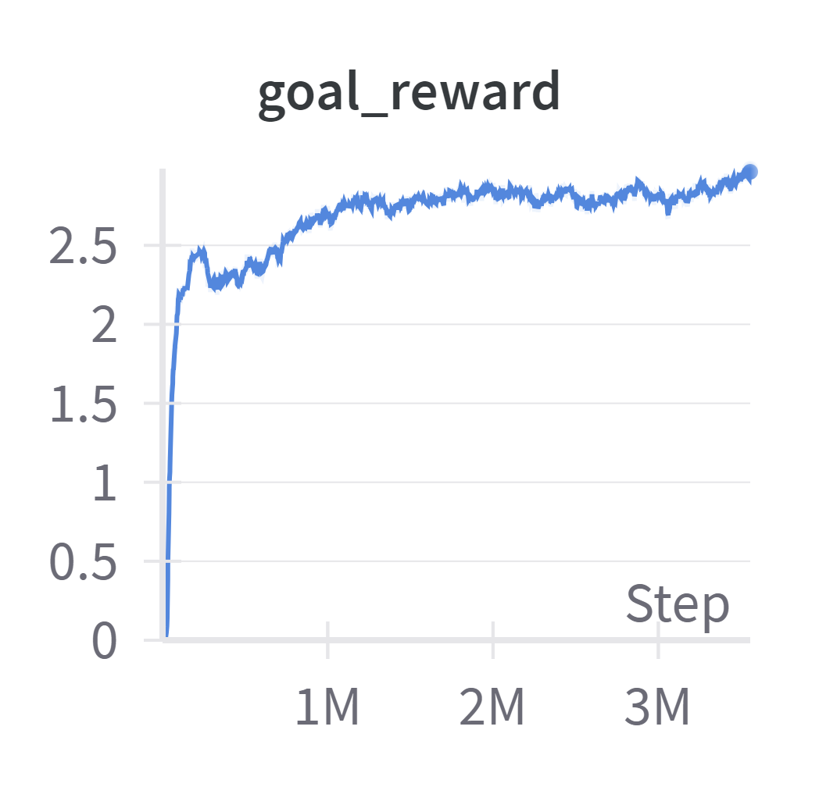
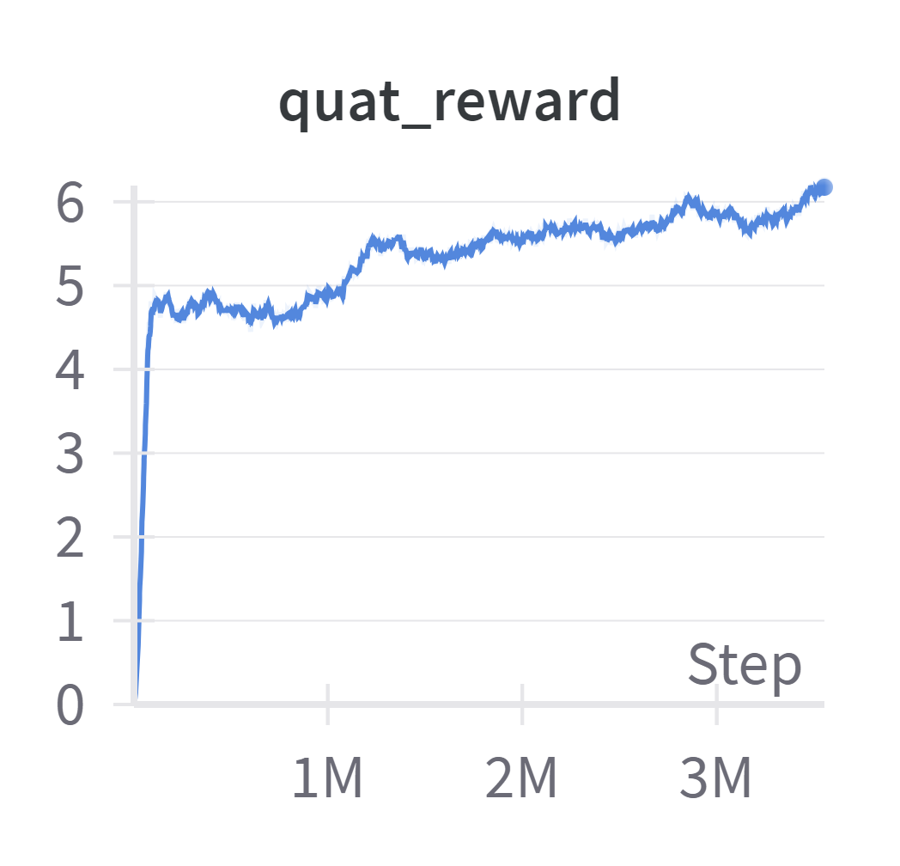
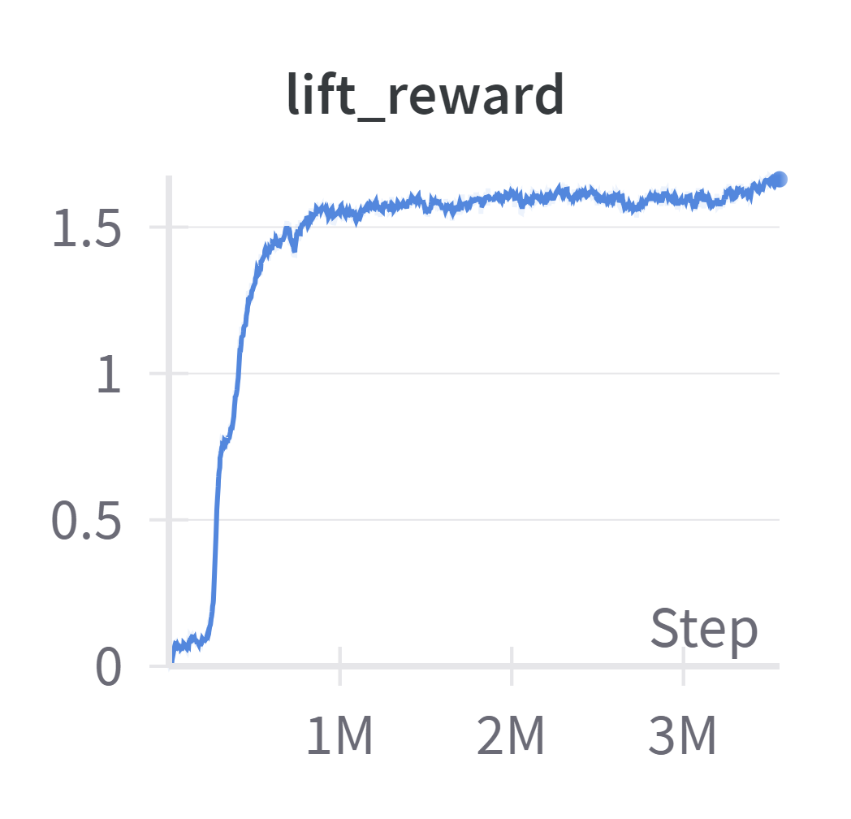
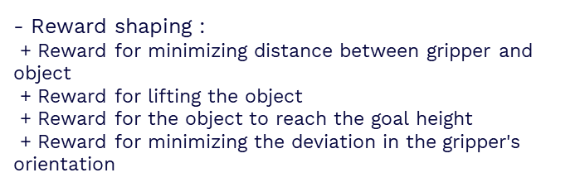
Set up the environment for training task
Learn to use tensors to represent high-dimensional data
Learn to use Isaac gym API to implement the task
Learn to modify the rewards for best performance
- Reward shaping :
+ Reward for minimizing distance between gripper and object
+ Reward for lifting the object
+ Reward for the object to reach the goal height
+ Reward for minimizing the deviation in the gripper's orientation
Learn to use wandb to plot the results

Slide 4
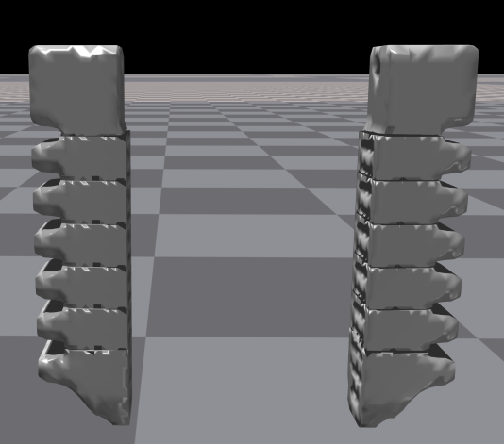
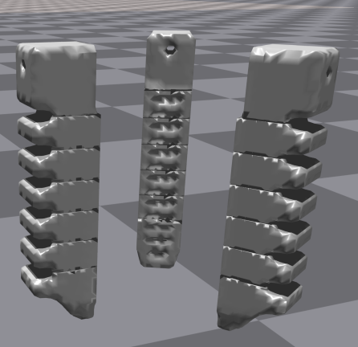
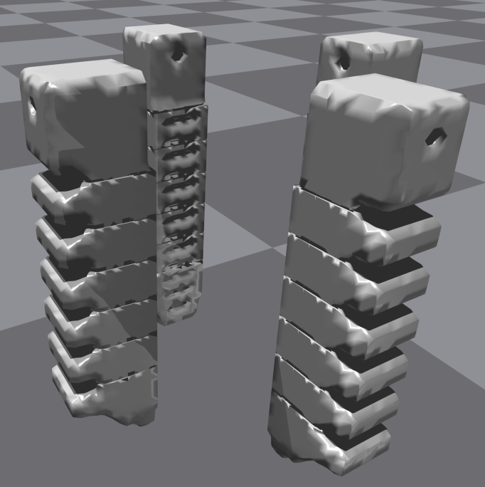
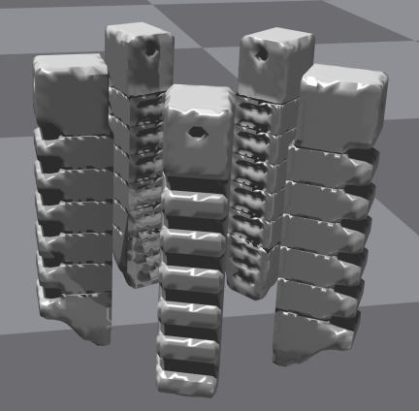
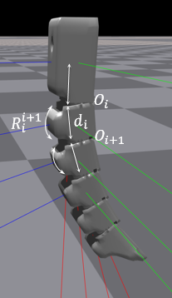
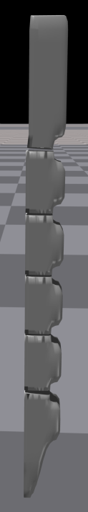
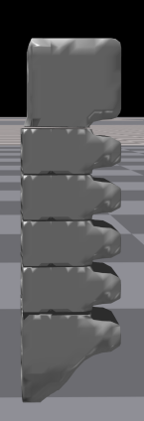
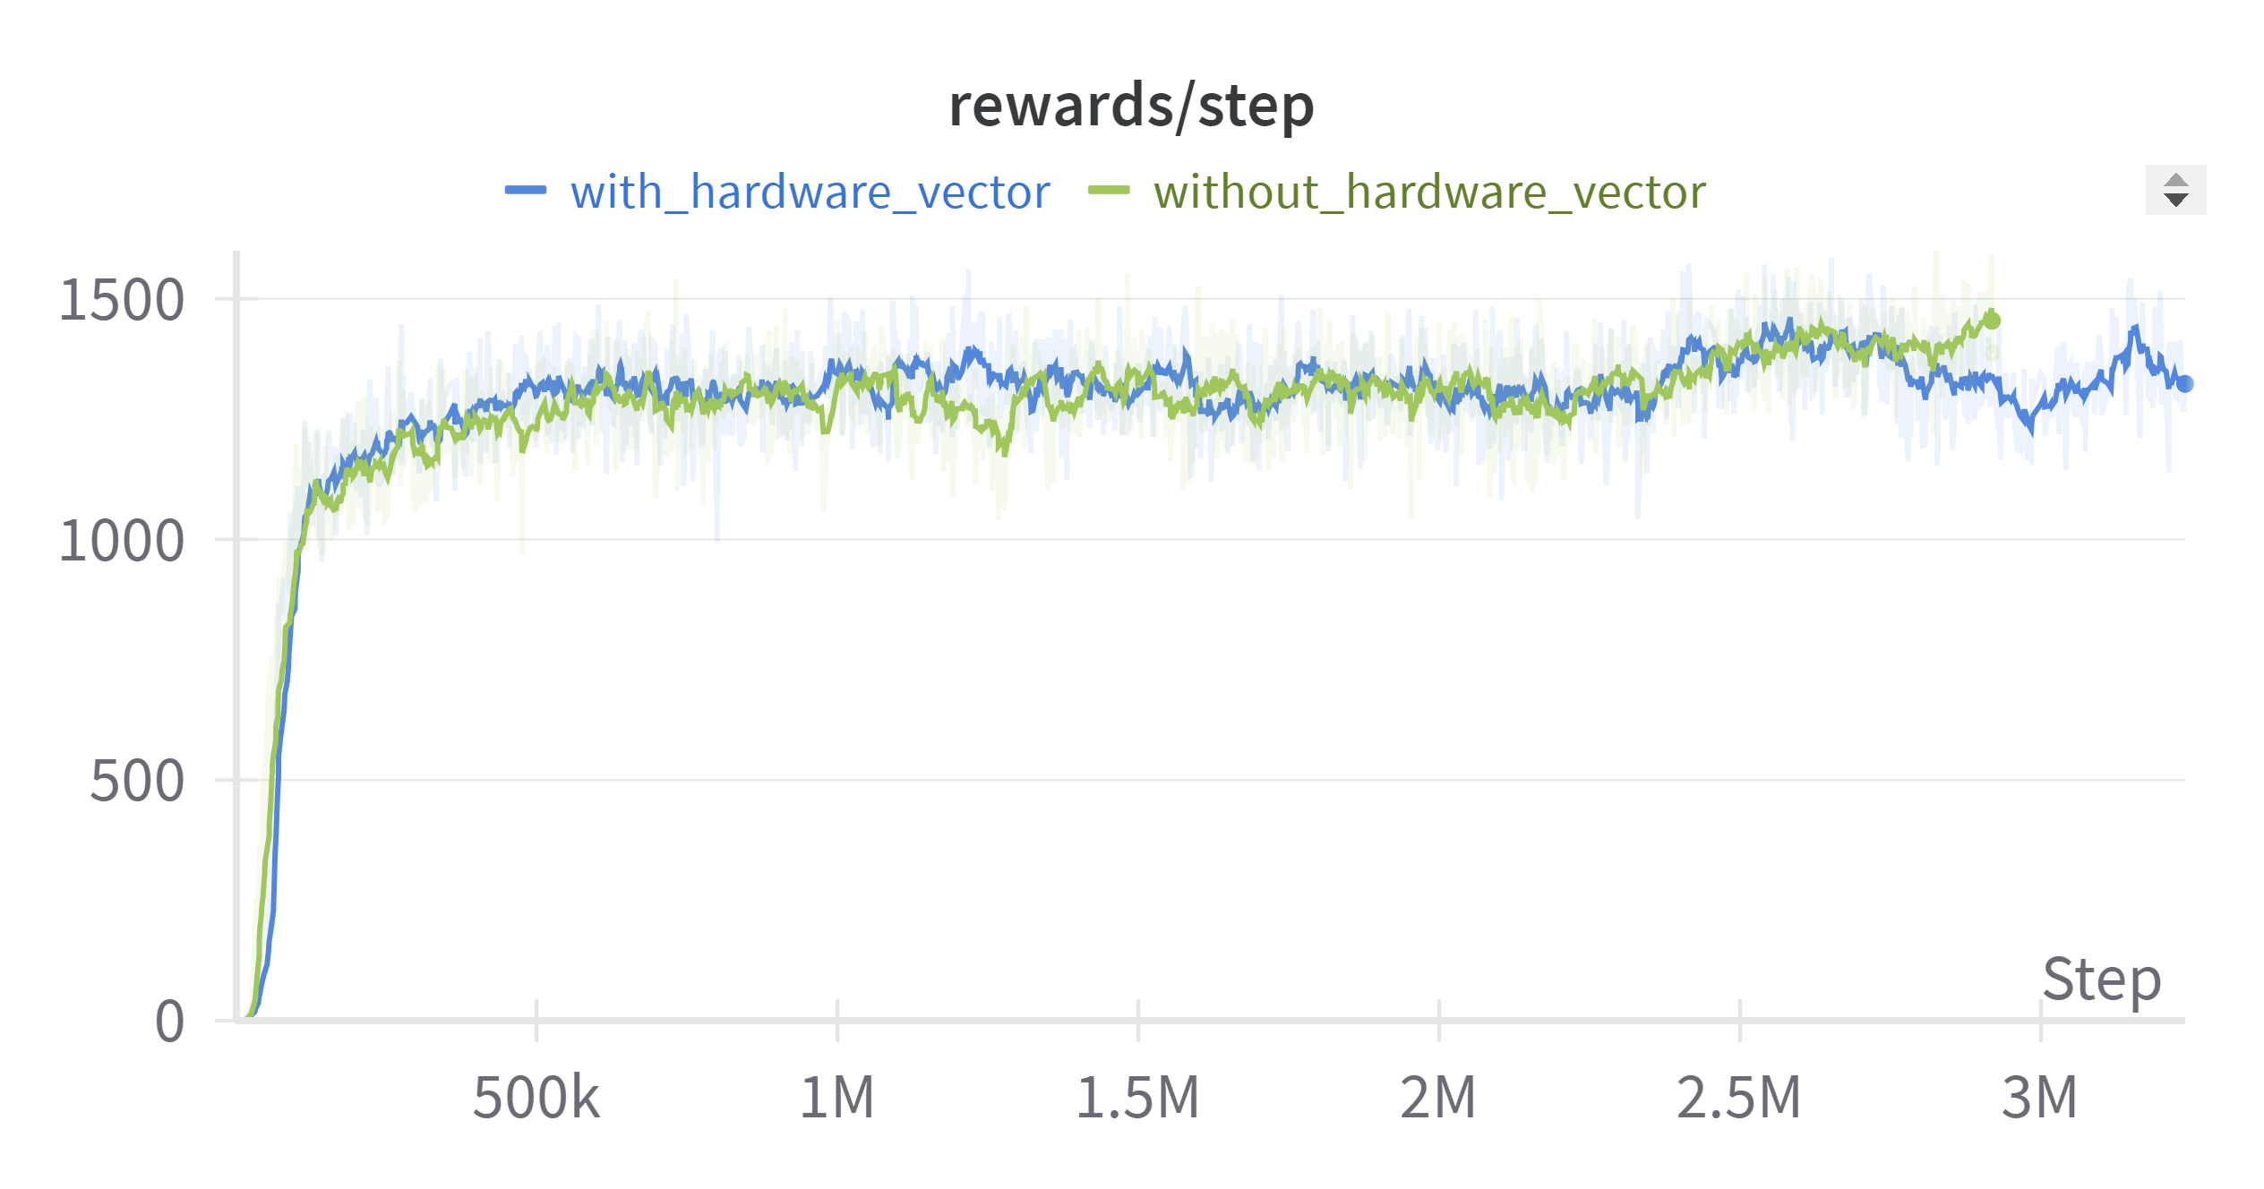
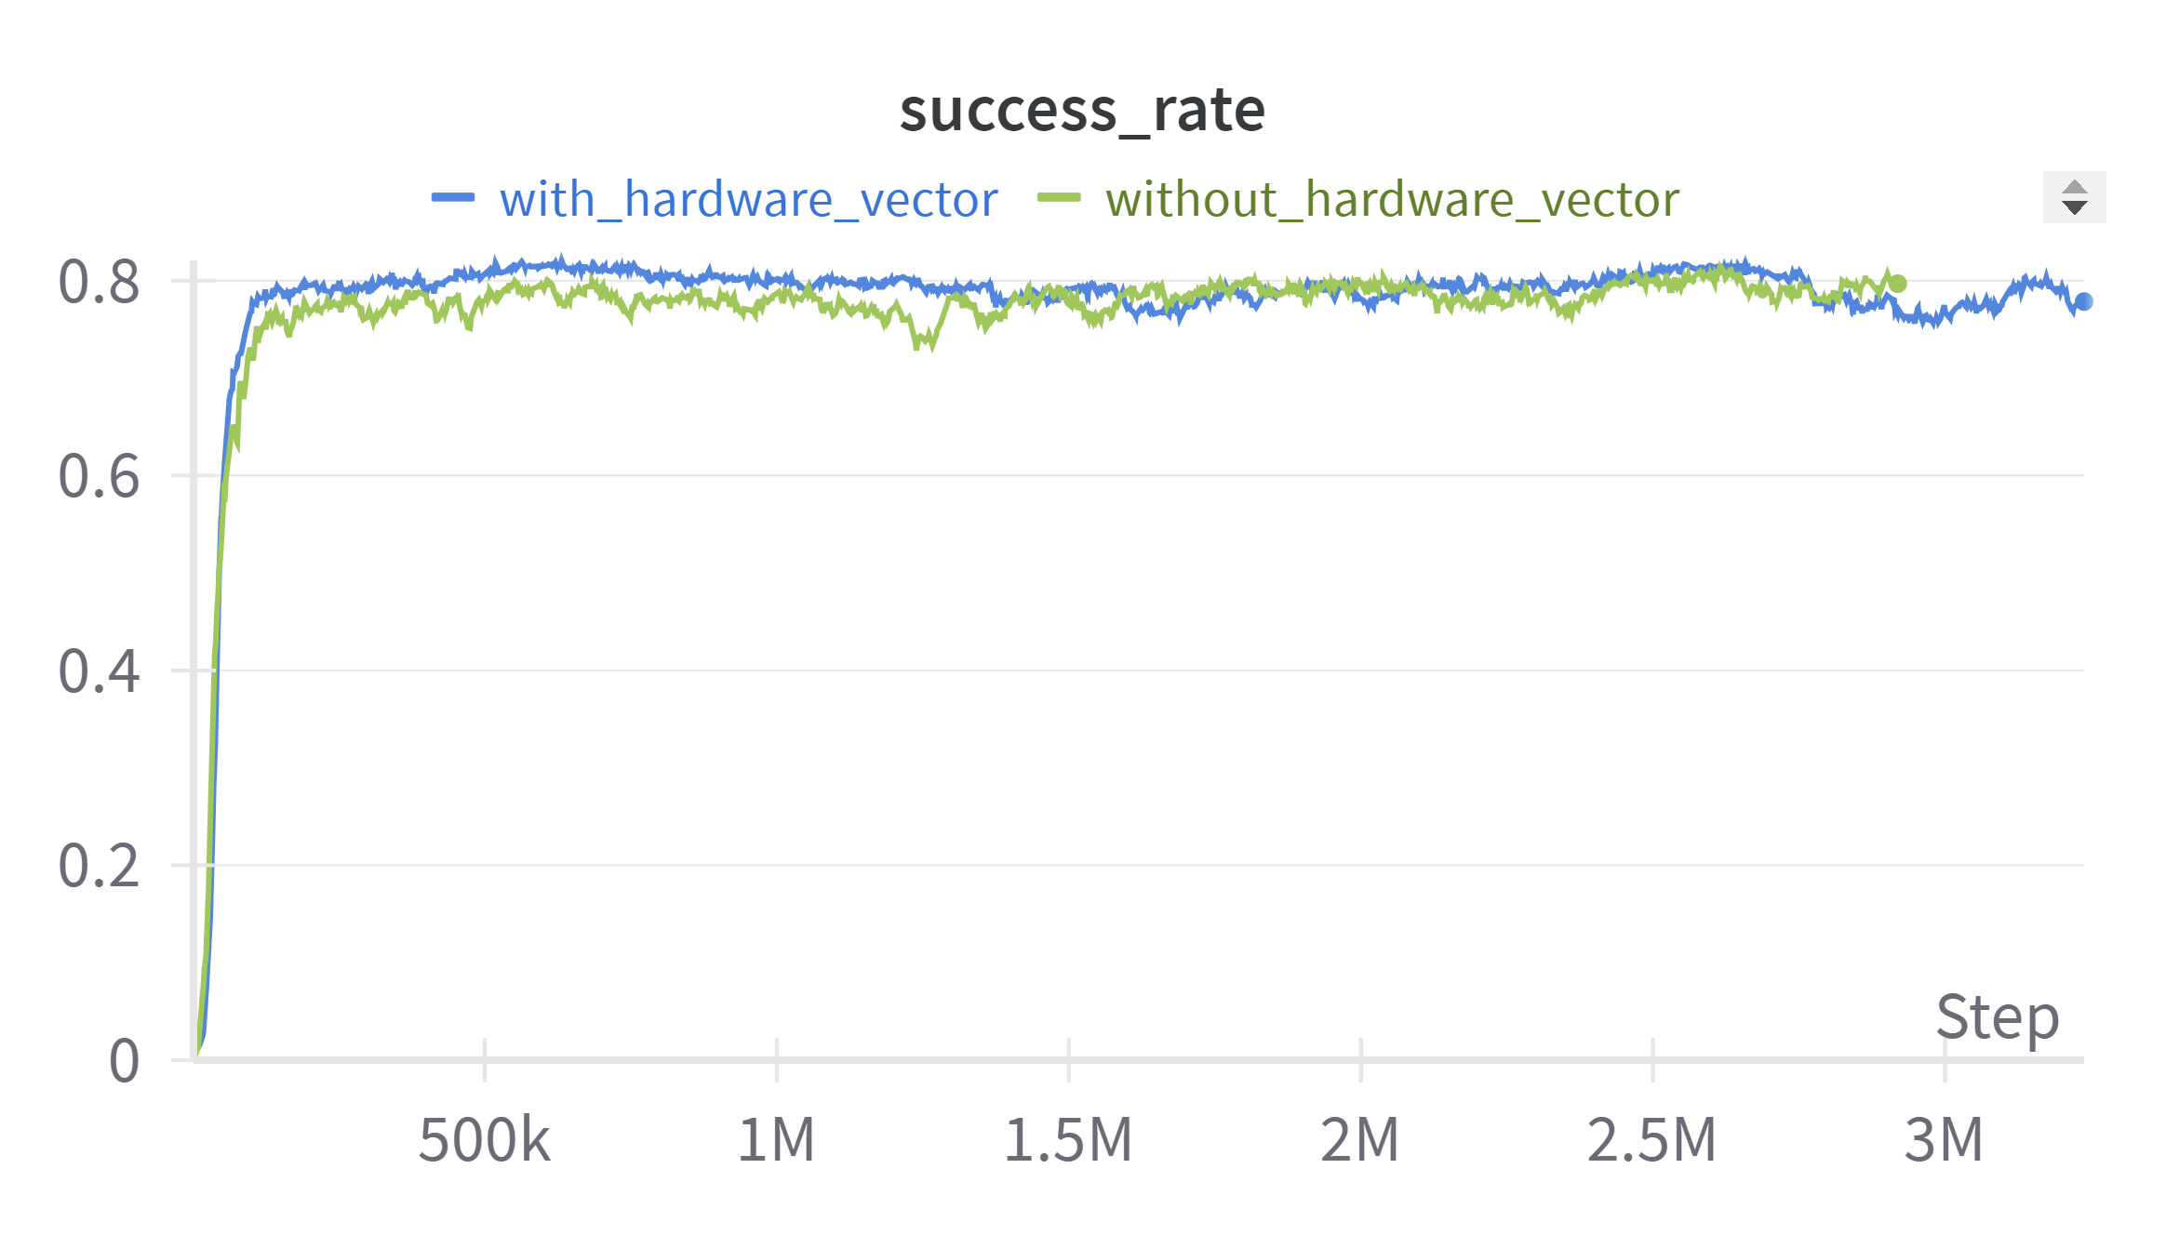



Training different types of grippers
- Create a set of different robot grippers based on a given 3-fingered gripper urdf file in Isaac Gym
Hardware vector $v_{h}:$ defined by relative pose $P_{i}$ of consecutive joints
relative distance $d_{i}$
relative orientation matrix $R_{i}^{i+1}$
$$v_{h}{=P}_{i}  P_{i+1} …$$

Slide 5
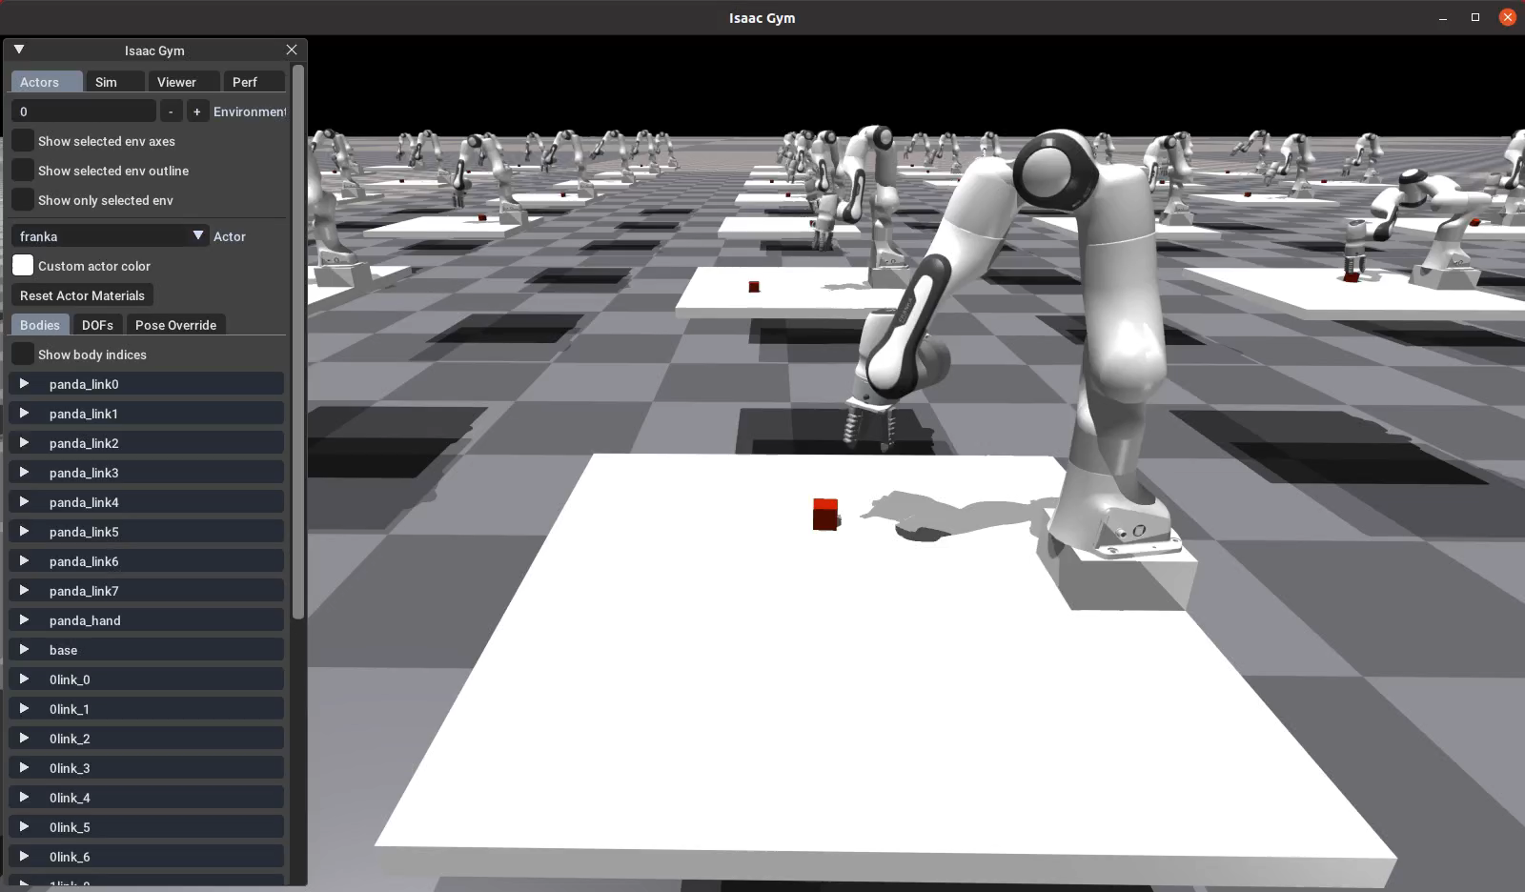
Franka Panda with soft gripper simulation
Operational Space Control for robot arm (OSC):
+ perform tasks in Cartesian space (end-effector's pose) instead of joint space (joint angles)
+ actions: desired end-effector pose → joint torques → gym.set_dof_actuation_force_tensor
→ Extract joint positions and velocities
calculate mass matrix
compute eef inertia matrix from jacobian tensor
→ transform Cartesian action to joint torques by PD-control

Slide 6
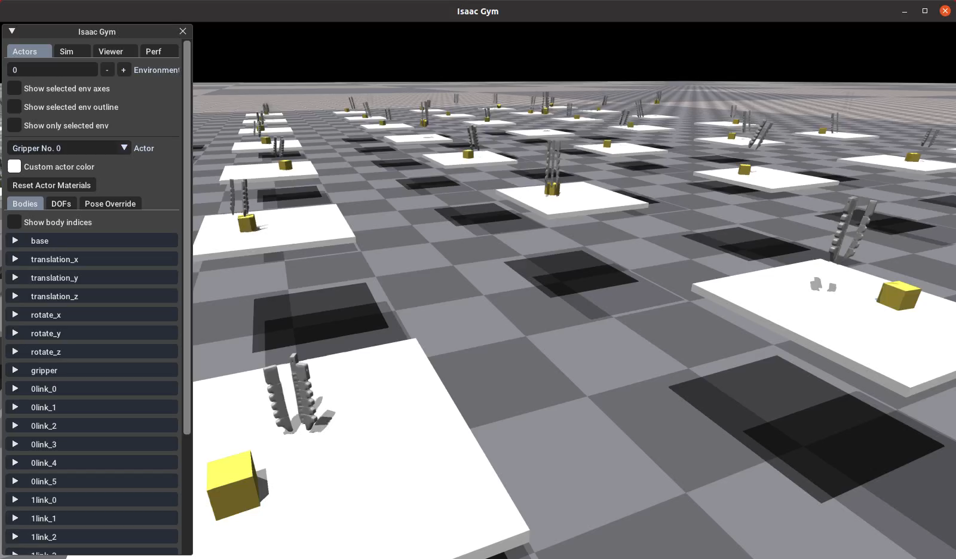
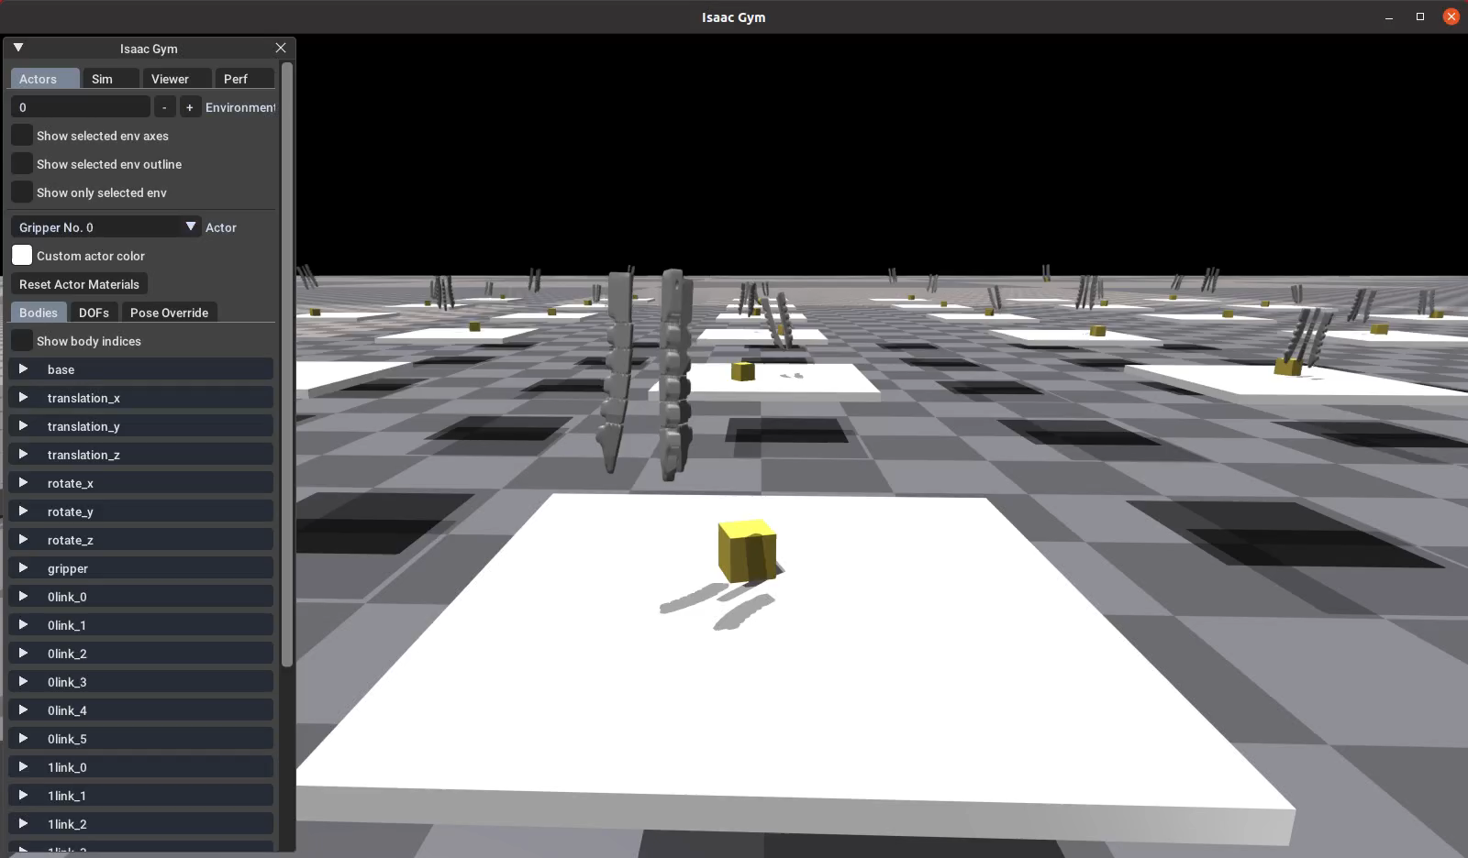
Set up environment for training using the learning algorithms built in taochenshh work
IsaacGymEnvs config
Taochenshh config

